Slide 1
CROPTA
Presented by:
Sachin Maharjan(27)
Nirusha manander(31)
Sagun lal shrestha(53)
Ruchi Tandukar(57)

Slide 2
CONTENTS
Introduction
Purpose
features
Methodology
Why python
System diagram
Flowchart
Limitation
Future enhancement
conclusion

Slide 3
INTRODUCTION
CROPTA is platform for students designed to make the study life easier to manage
Tracks your assignments, exams, classes and classroom events
Stores your tasks in the cloud so it is easily accessible
Manages your study plans in computerized system

Slide 4
PURPOSE
  To replace paper planner with computerized system
  To keep track of assignments, exams and class schedules
  To manage time more effectively

Slide 5
Why Android Studio ?
It is the most poplar and easy to use IDE to develop android application
It has many built in functions, classes that help develop android application
It has many tutorial videos and documentation to make learning it easier

Slide 6
Why firebase?
Real time database that is needed for our application
Dedicated database system for android and web development
Syncing data in all devices
Doesn’t require server

Slide 7
Features
Realtime Database
Class Routines
Teacher info
Assignment
Events
Exam schedules

Slide 8
System Diagram:
CROPTA
Dashboard
Profile
Using Firebase
Real-time
database
Routine
Assignment
Routine
Exams
Teacher info
Using Sqlite
Offline
Database
Note and Planner
Event

Slide 9
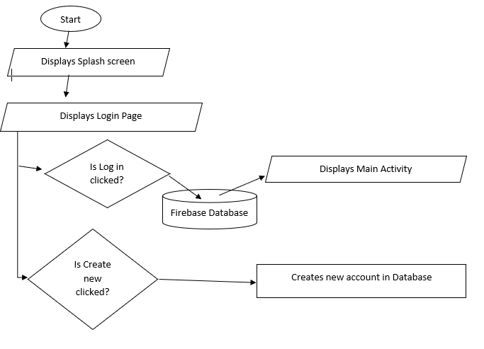
Main Flow Chart for application

Slide 10
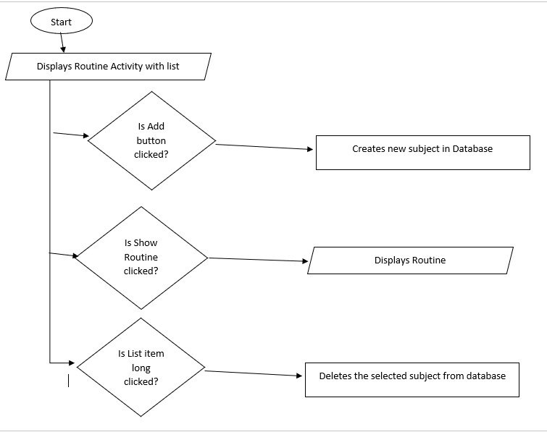
Routine Flow Chart

Slide 11
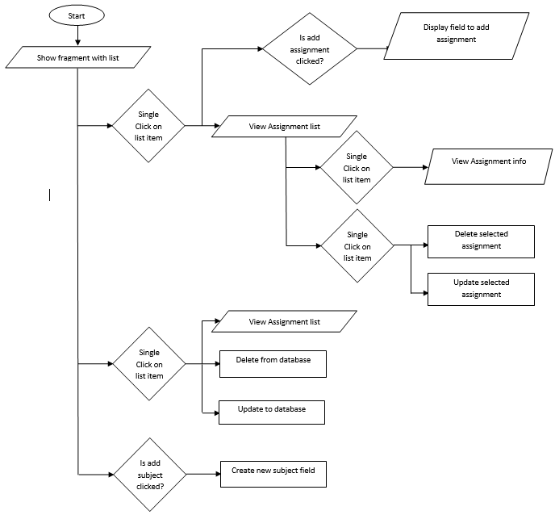
Assignment Flow Chart

Slide 12
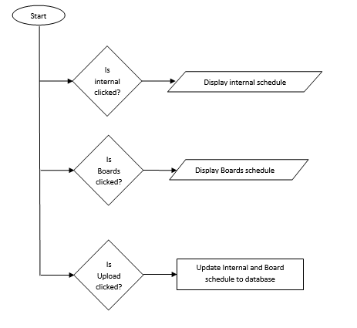
Exam schedule flow chart

Slide 13
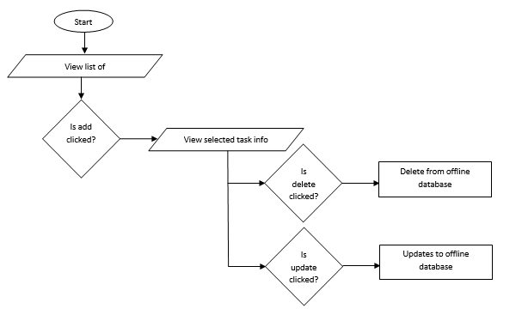
Notes planner

Slide 14
FUTURE ENCHANCEMENT
Multiple time for a subject
Administrator user can be added
Create a offline database that syncs with cloud database when internet access is available

Slide 15
Limitation
Internet is always necessary
Routine display is static
One subject has only one time that too is of one hour
Notification and reminder is not available

Slide 16
Conclusion
Learning how to use a popular new language and IDE
Develop a application that could be used by students in their day to day life
Learn and use NoSQL(Firebase) database

